Slide 1

1. Linux

Slide 2
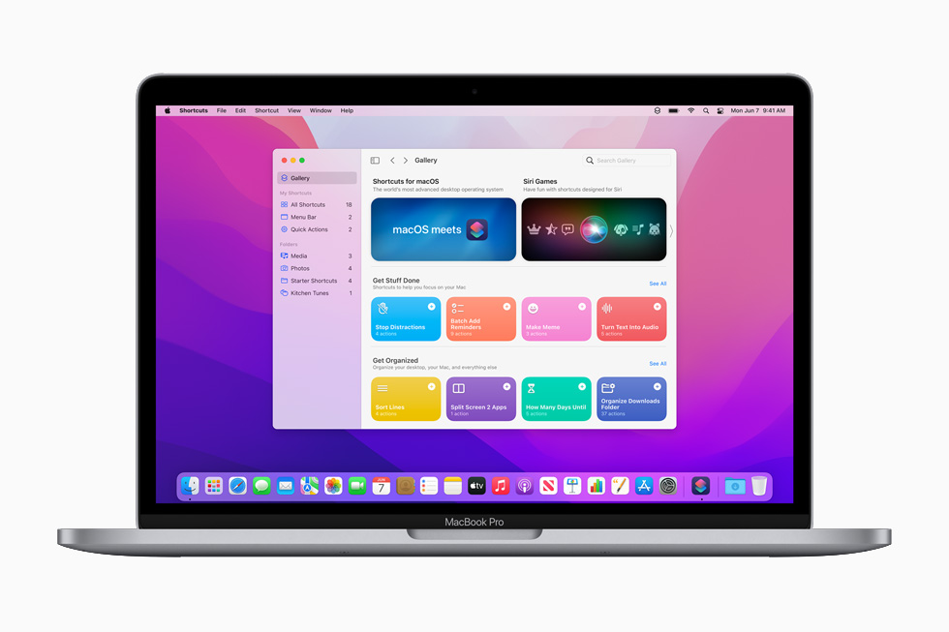
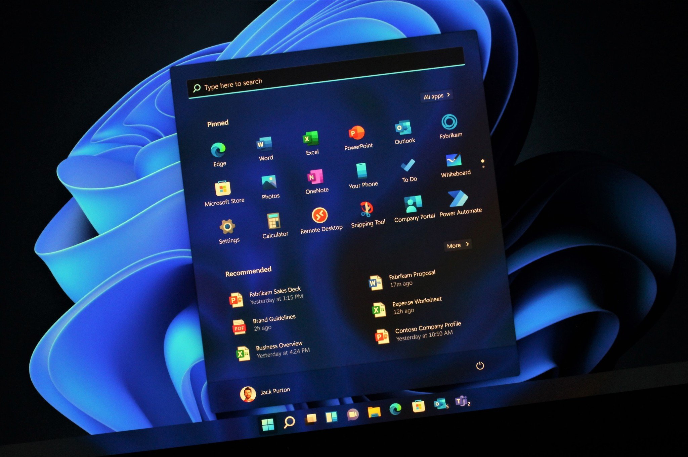
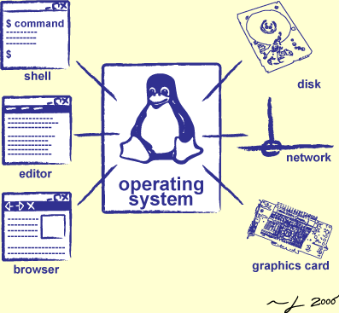

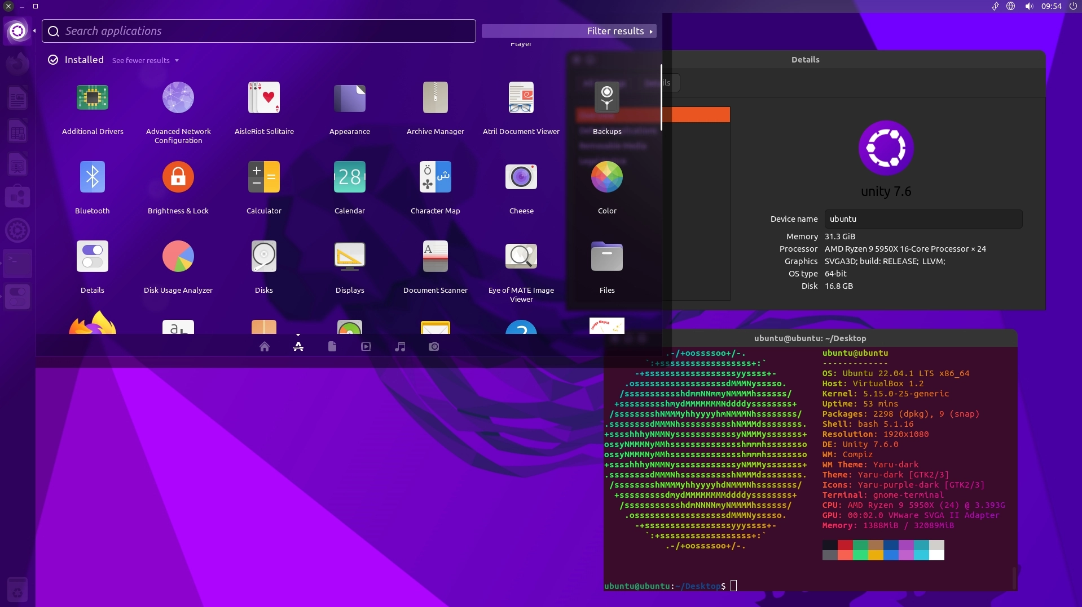
Windows
Mac OS
Linux
Chrome OS

Slide 3
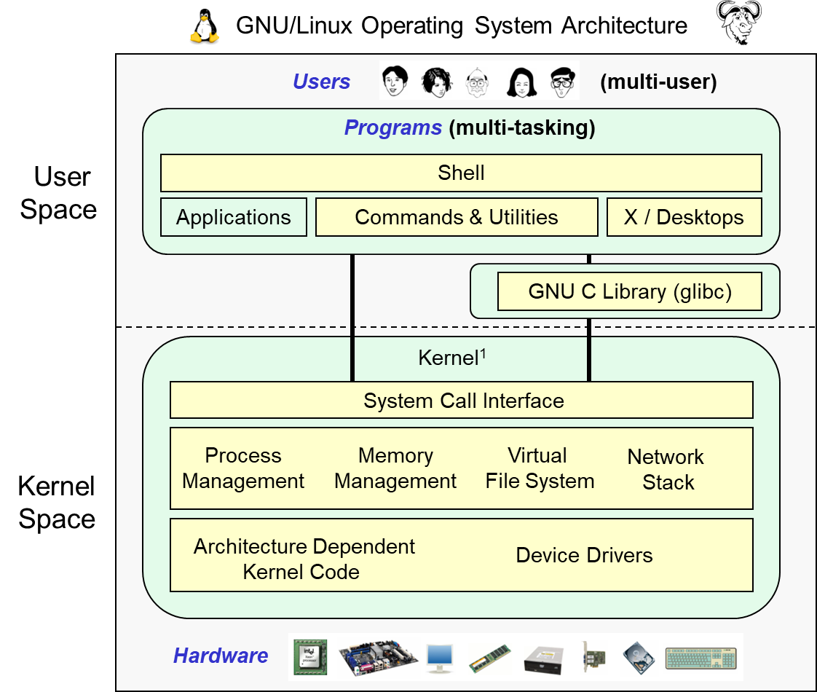
UNIX System Structure

Slide 4
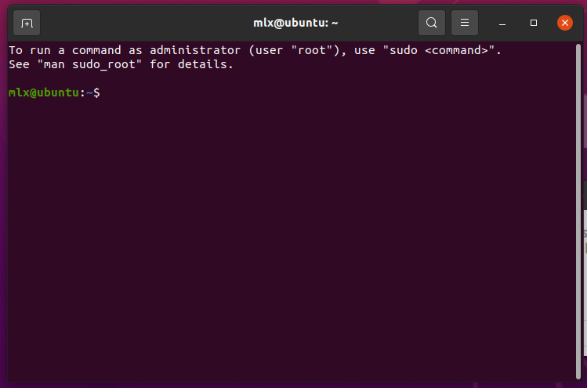
Shell: 与内核交互的文字接口
Ctrl + Alt + T

Slide 5
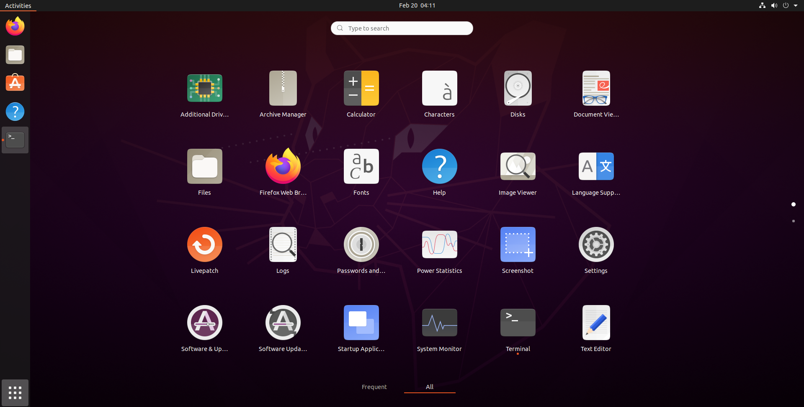
Shell: 与内核交互的文字接口

Slide 6
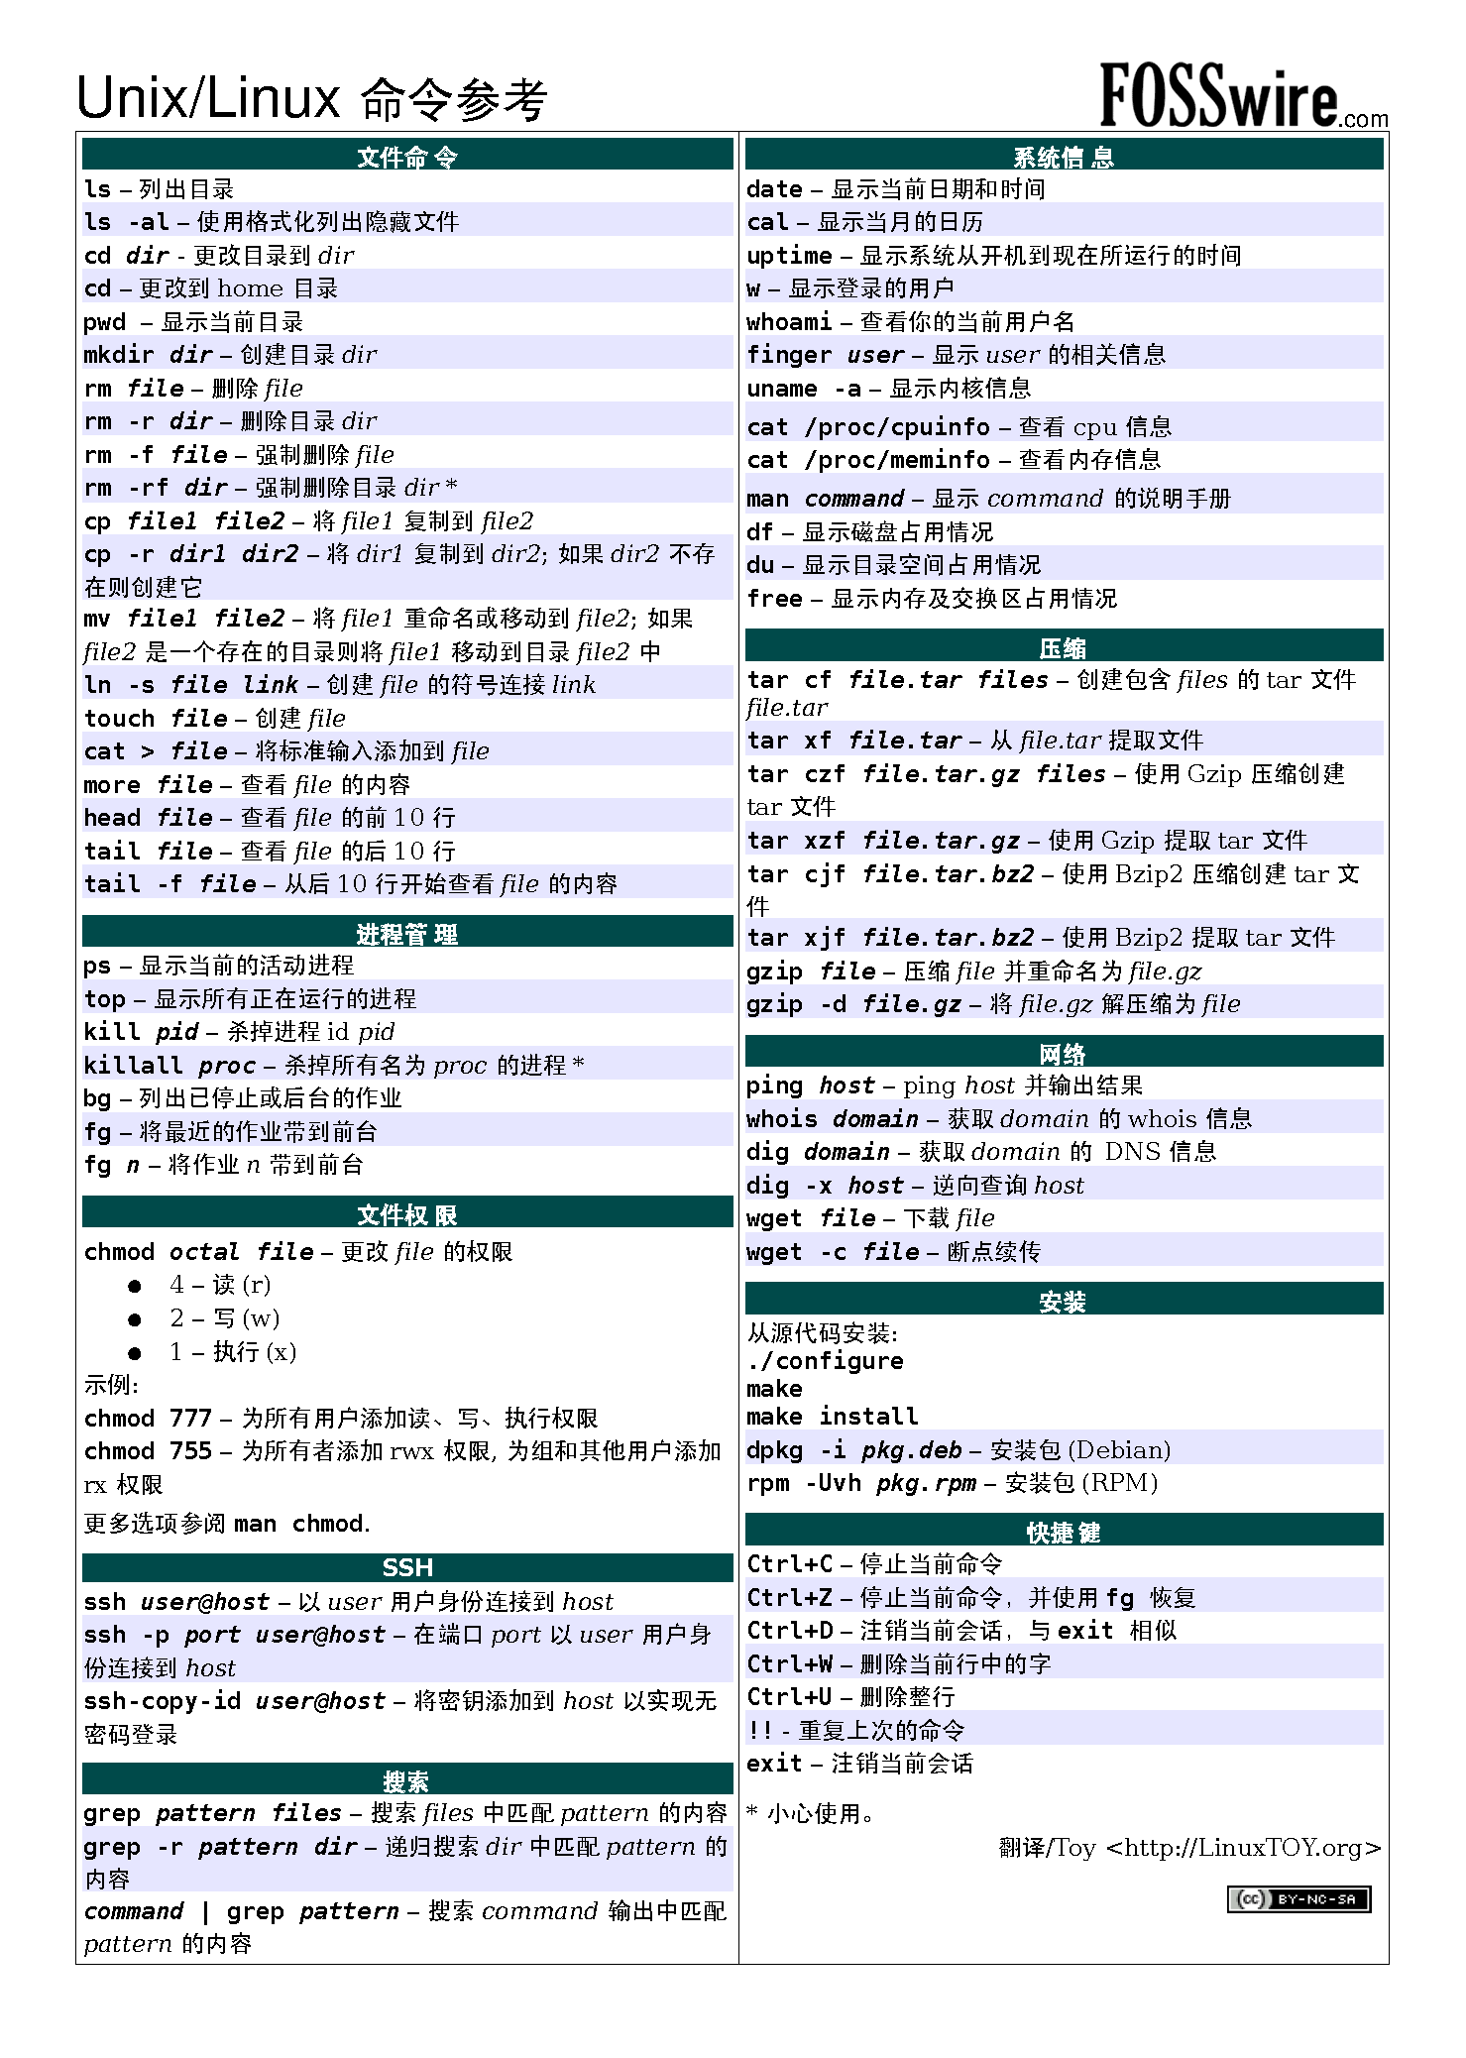

Slide 7
Linux发行版
Linux 发行版（Linux distribution）为一般用户预先集成好了Linux内核及各种应用软件
典型的Linux发行版包括Linux内核、GNU工具和库、附加软件、文档、窗口系统(最常见的是X窗口系统，或者最近的Wayland)、窗口管理器和桌面环境

Slide 8
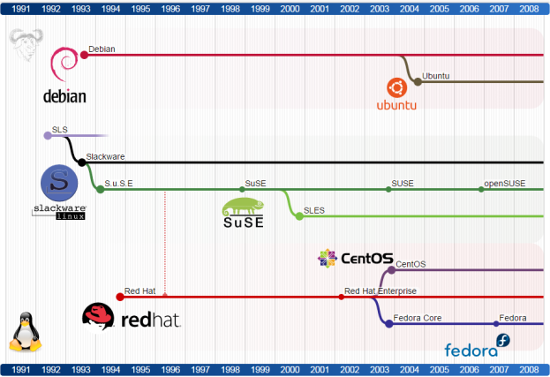
Linux发行版

Slide 9
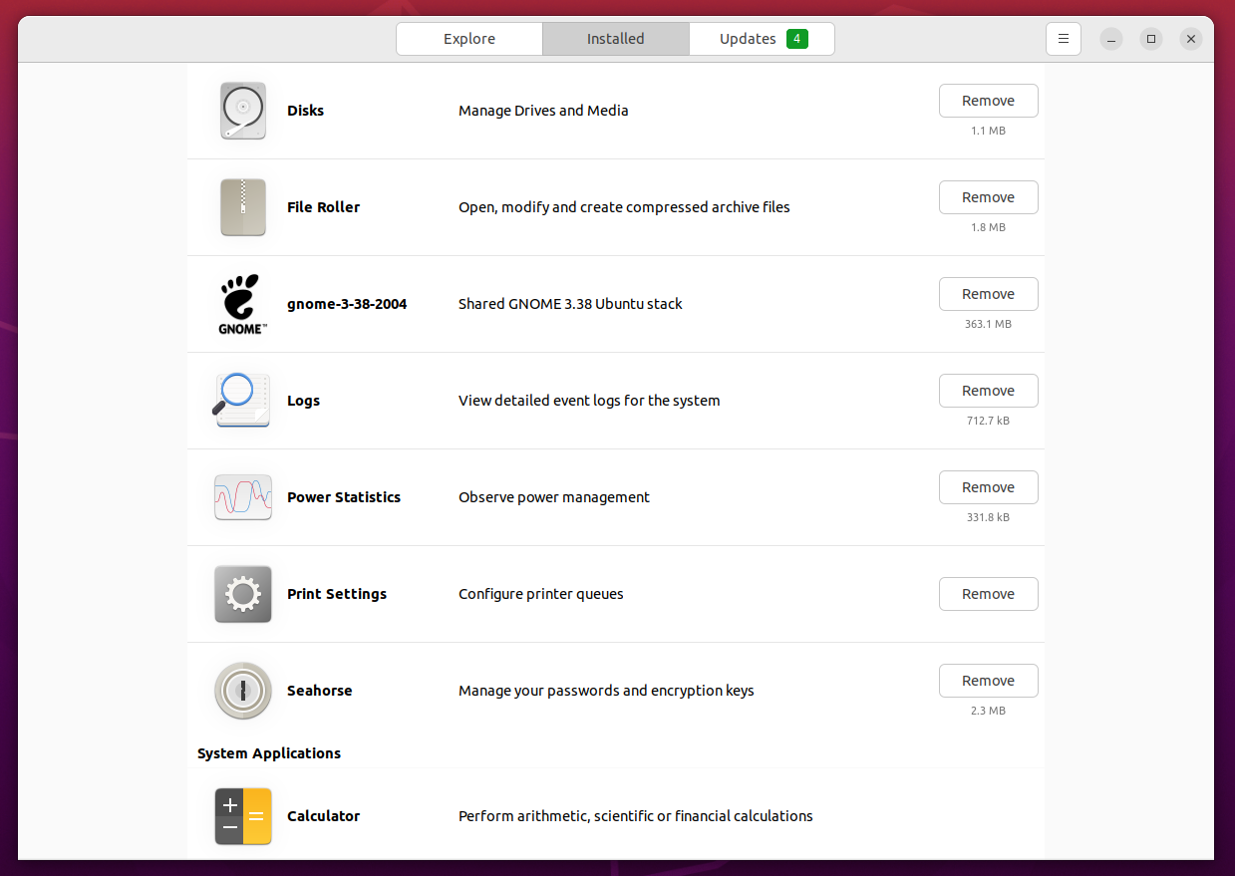
软件包管理系统
软件包管理系统是在电脑中自动安装、配制、卸载和升级软件包的工具组合

Slide 10
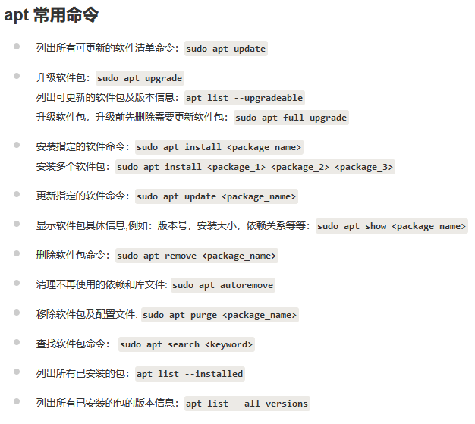
软件包管理系统

Slide 11
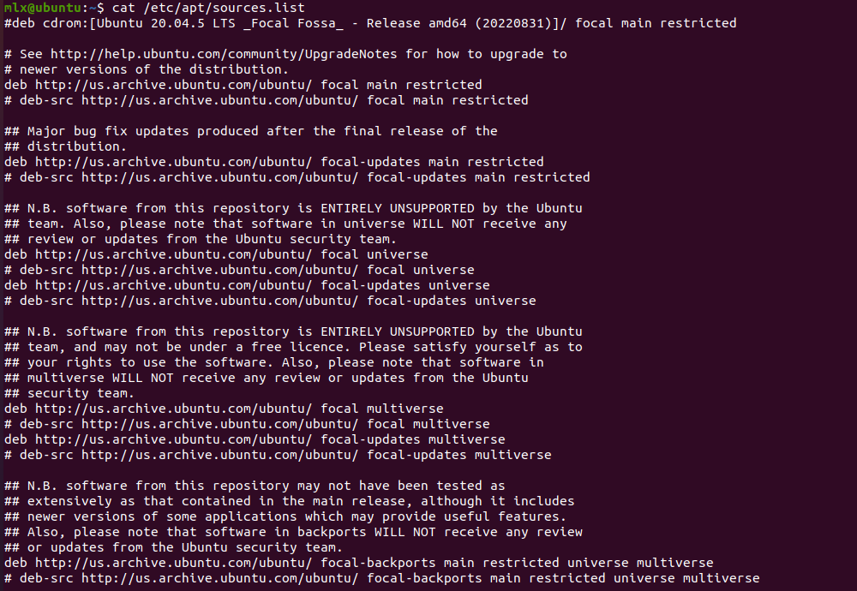
Ubuntu Mirror

Slide 12
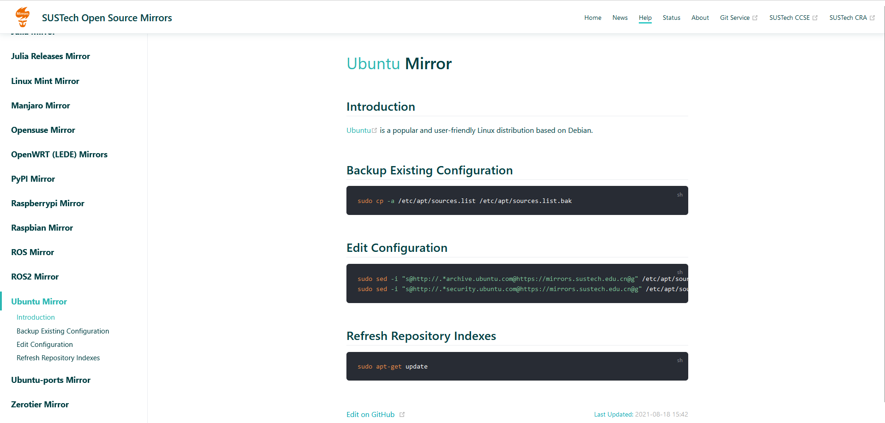
http://mirrors.sustech.edu.cn/help/ubuntu.html#introduction

Slide 13

2. Robot Operation System

Slide 14
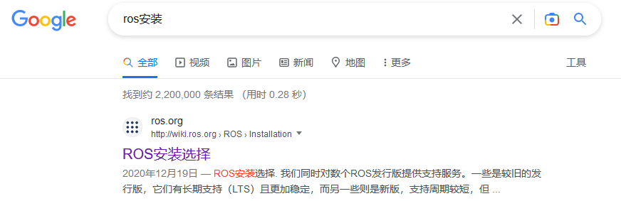
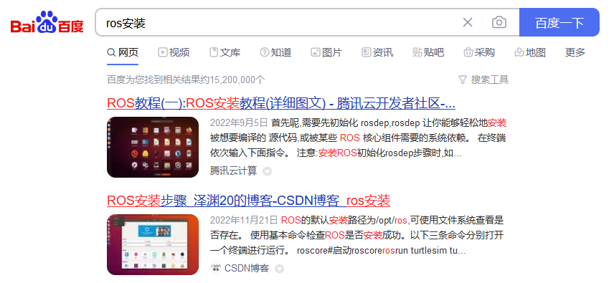
WIFI: EE368
密码: ee368ee368

Slide 15
ROS安装
http://wiki.ros.org/noetic/Installation/Ubuntu或者
http://mirrors.sustech.edu.cn/help/ros.html#introduction

Slide 16
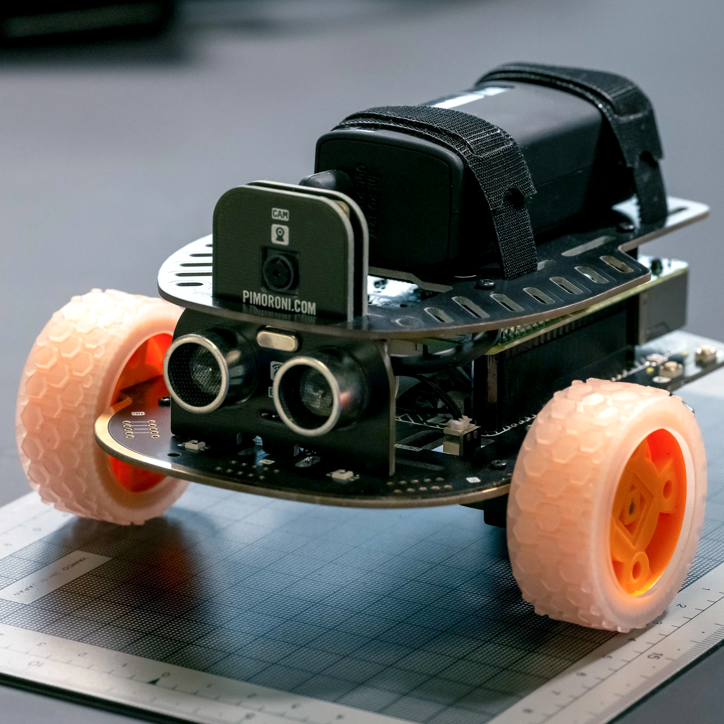
目标：跟随特定物体并实时避障
电池
摄像头
超声传感器
电机

Slide 17
Challenges encountered in robotics
The world is asynchronous
Robots must manage significant complexity
Robot hardware requires abstraction

Slide 18
Solution 1: “Callbacks”
Callback:
Function which is called whenever data is available for processing.
An asynchronous callback can happen at any time.
Examples:
Run the relevant callback function whenever:
An image is read from the camera
The odometry sensor reports new data
void imageCallback(ImageMessage image)
// process the latest image
void odometryCallback(OdometryMessage data)
// handle latest odometry data
void main() initialize();
subscribe(“image_msgs”, imageCallback);
subscribe(“odometry_msgs”, odometryCallback);

Slide 19
Problem 2: Complexity Solution 2: Organizing code
Separate processes: Cameras, Odometry, Laser Scanner, Map Building can all be separated out: they’ll interact through an interface
Interfaces: Software processes (“nodes” in ROS) communicate about shared “topics” in ROS
Publish/Subscribe: Have each module receive only the data (messages) it requests
Topic: /camera/image
Face Detection
Image Message
Camera
Image Message
Obstacle Detection
Obstacle
PointCloud
Laser Scanner
Map Building
19
Topic: /kinect/cloud
Notes:
Message passing = Interface
Nodes: Sensors/Algorithms/High-level algorithms
Edges: Topics sent across for communication

Slide 20
Problem 3: Hardware dependent code Solution 3: Abstracting hardware
Hardware-Independent Software
Device-Specific Drivers
Face Detection
Image Message
Camera
Obstacle Detection
Image Message
PointCloud
Laser Scanner
Obstacle
PointCloud
Map Building
Motors
Interface
Etc.
Notes:
Can also mention the fact that we want code to be agnostic to the type of hardware our code is running on top of -- both at driver level, and at morphology level.
Nodes: can be hardware independent or hardware-specific
Segway: You’ve built your robot, how to make it work for these … (next slide)

Slide 21

A meta-operating system for robots

Slide 22
What is ROS?
A “Meta” Operating System.
Open source
Runs in Linux (esp. Ubuntu)
Agent based (nodes)
Message passing
Publish
Subscribe
Services via remote invocation
Supports numerous programming languages (C++, Python, Lisp, Java)

Slide 23
What is ROS?
Application building blocks
ROS
Low level device abstraction
Joystick
GPS
Camera
Controllers
Laser Scanners
…
Application building blocks
Coordinate system transforms
Visualization tools
Debugging tools
Robust navigation stack (SLAM with loop closure)
Arm path planning
Object recognition
...
System software

Slide 24
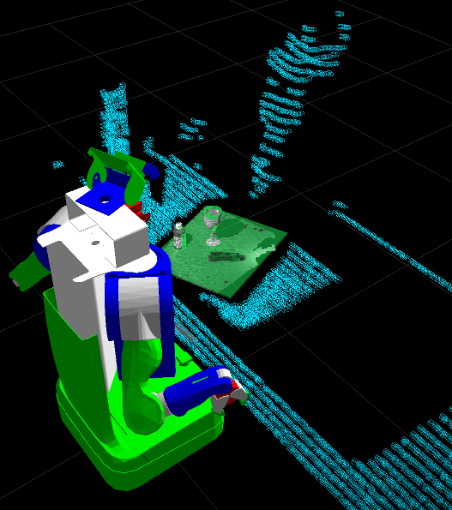
ROS Visualization
Visualize:
Sensor data
Robot joint states
Coordinate frames
Maps being built
Debugging 3D markers
VIDEO
Notes:
(A) rviz (demo): tap into any message stream and visualize (if plugin available) Demo will show visualization of point clouds, robot joint states, coordinate frames, user-added markers

Slide 25
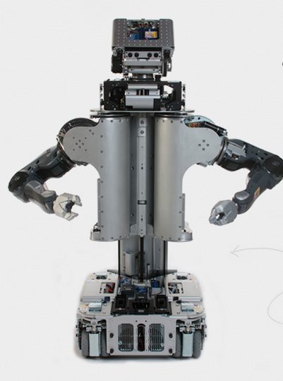
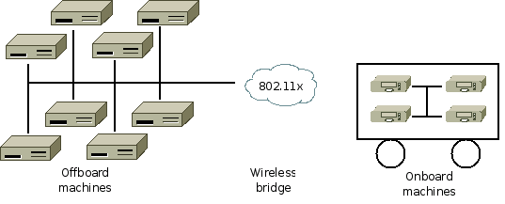
What is ROS?
Software management (compiling, packaging)
Remote communication and control

Slide 26
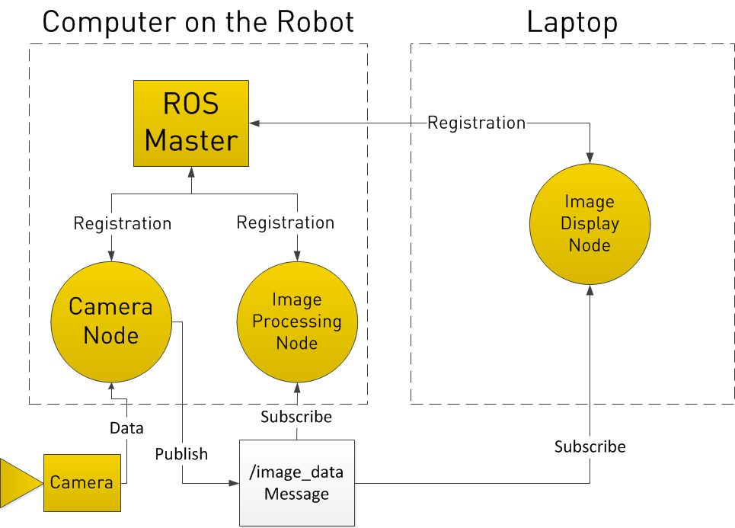

Slide 27
ROS Tutorials
http://wiki.ros.org/ROS/Tutorials

Slide 28

3. Python

Slide 29
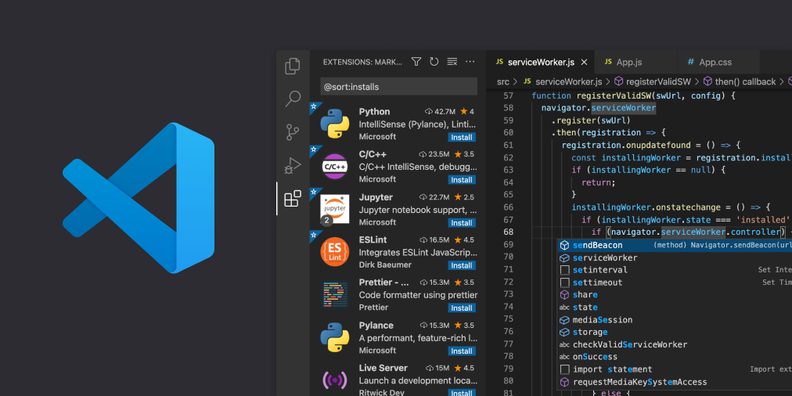
Visual Studio Code
https://code.visualstudio.com/Download

Slide 30
Python Tutorial
https://www.w3schools.com/python/default.asp

Slide 31

4. Git & Github

Slide 32
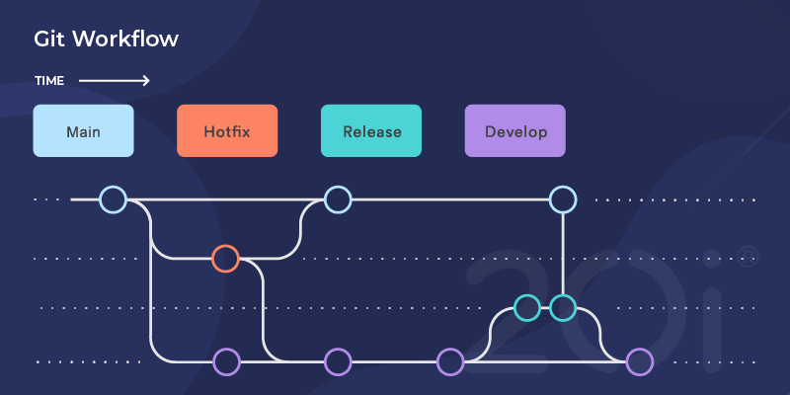
Git:版本控制系统

Slide 33
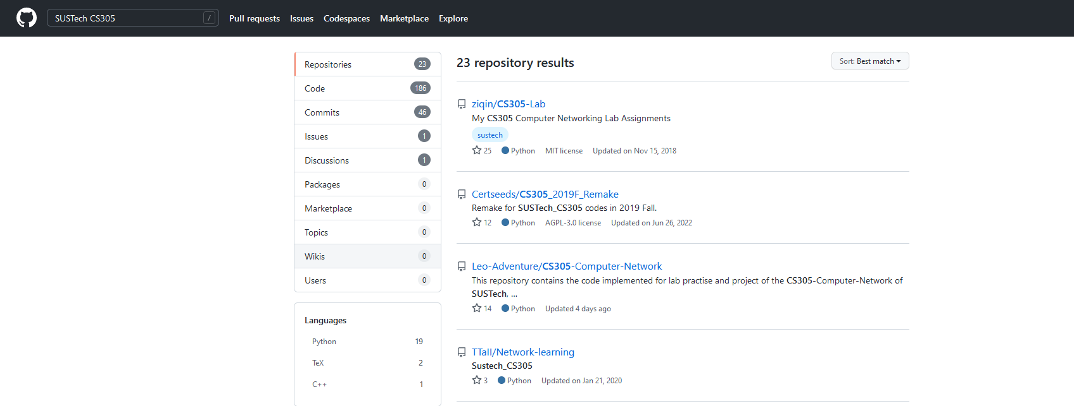
Github

Slide 34
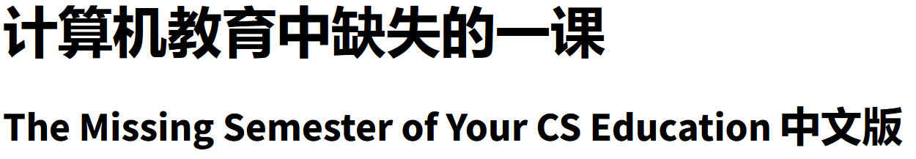
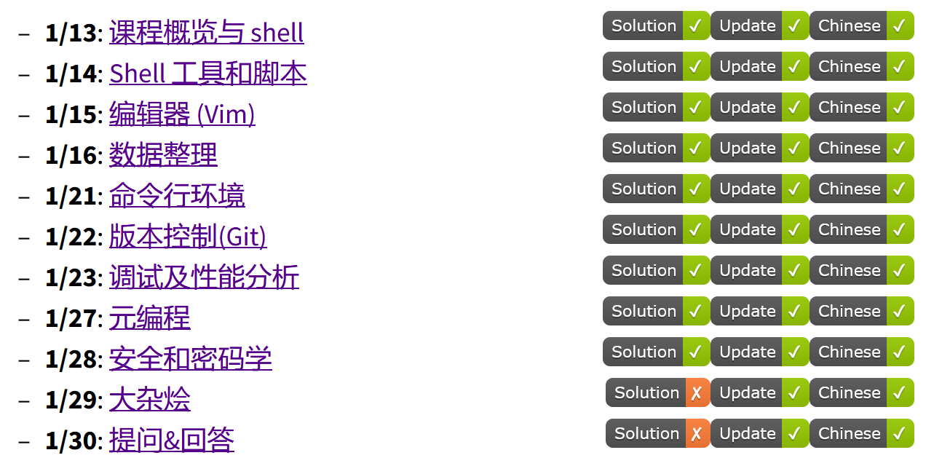
https://missing-semester-cn.github.io/

